Slide 1



Mechanical Engineering Master’s Thesis Defense
Candidate: Jakob Frabosilio
Committee: Dr. John Ridgely (chair)
Charlie Refvem
Dr. Siyuan Xing

Slide 2
Presentation Outline
Introduction
Ground-Truth Positioning System
Acoustic Positioning System
Absolute Orientation and Dead Reckoning
Kalman Filtering
Data Collection and Results
Conclusion and Future Work

Slide 3
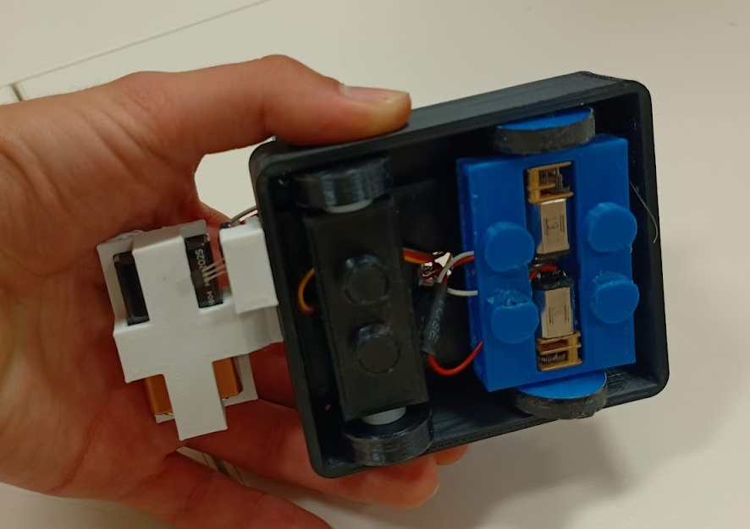
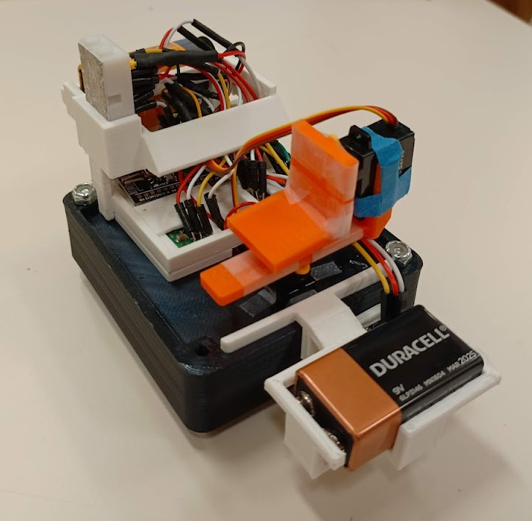
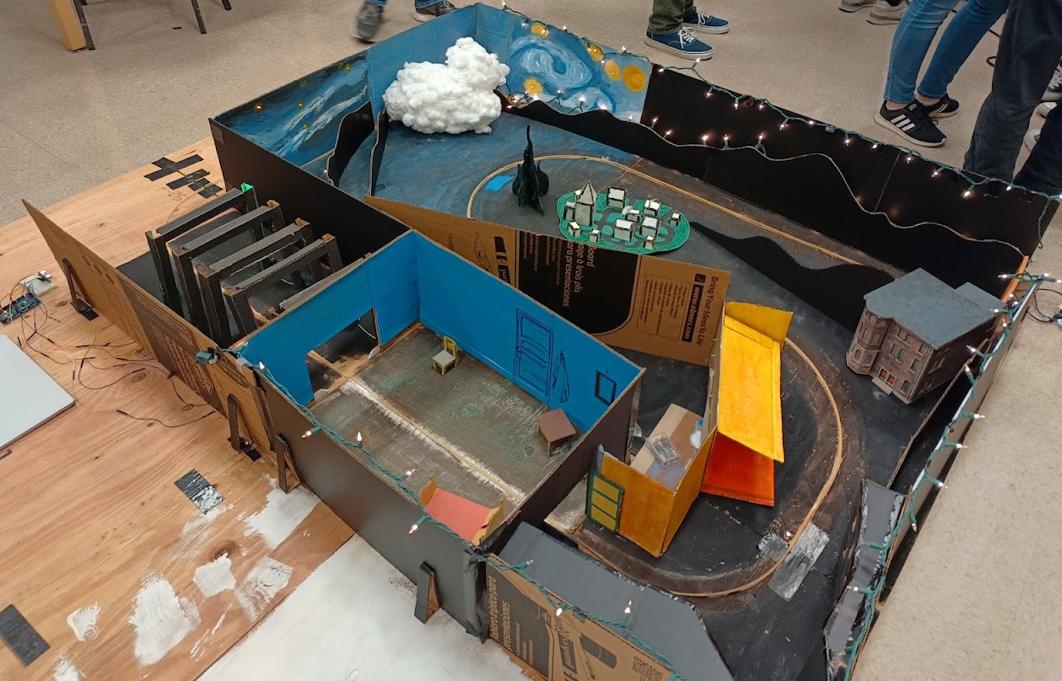
Self Introduction
Jakob Frabosilio
Started B.S.M.E. in 2018
Started M.S.M.E. in 2022
Member of Cal Poly Mustang Band for all six years of college
First mechatronics project in Sep 2019
Dark Ride: CAPED Project
Designed ride vehicle
Notes:
Introduce myself to the audience

Slide 4
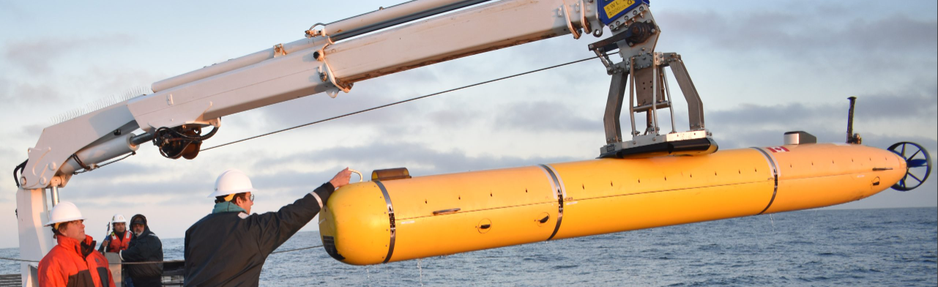
Problem Definition
Autonomous Underwater Vehicles (AUVs) are used to collect data in the ocean and require position information
Examples: shipwrecks, ocean floor mapping, phytoplankton level monitoring, search-and-rescue, and so much more
Problem: GPS does not work underwater!
Need a way to reliably determine AUV location when submerged for long periods of time
Notes:
Define the problem that the thesis is tackling

Slide 5
Existing Solutions*
Solution | Benefits | Drawbacks
GPS/GNSS | Moderate accuracy (~7m) Does not drift over time | Does not work underwater (surfacing required)
Dead Reckoning | High accuracy for small ΔT Local solution | Estimate drifts over time High sampling rate required
Simultaneous Localization and Mapping (SLAM) | Creates map of environment Local solution | High computational cost Requires precise SONAR
Acoustic Positioning | Sound travels far in water Does not drift over time | Requires line-of-sight Noise pollution concerns
Muometric Positioning | Works anywhere on Earth Very high accuracy (3.9cm) | Very recent research (2023) Not many implementations
Notes:
Show examples of solutions to the problem

Slide 6
My Approach*
Combine acoustic positioning, dead reckoning, and GPS
Buoy on surface of water with GPS and acoustic transmitter
GPS provides absolute reference to global frame
AUV with microphone array and dead reckoning equipment
Acoustic positioning provides relative reference to GPS
Dead reckoning provides short-term relative position
Use sensor fusion to blend three methods
Test system above-water, extrapolate to underwater
Lower cost, no waterproofing req’d, lower speed of sound
Notes:
Explain combined approach / what each element does

Slide 7
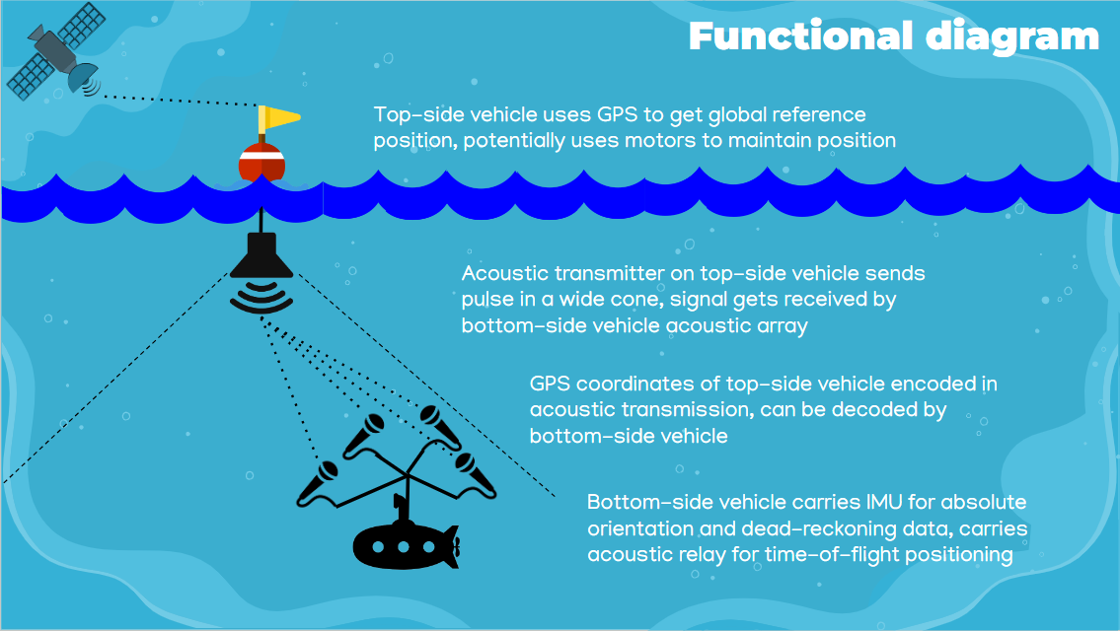
Functional Diagram
Notes:
Show combined approach

Slide 8
High-Level Overview
Use ground-truth positioning system to verify accuracy, simulate motion of AUV underwater
Transmitter sends out a pulse of ultrasonic sound
Four microphones on receiver array record the pulse
Time difference between microphone signals is calculated
Position of transmitter estimated using time differences
Array orientation and dead reckoning estimated using IMU
Fuse estimates with a Kalman filter
Position estimate of array is compared to ground-truth
Notes:
Give summary of work for thesis

Slide 9
Ground-Truth Positioning System

Slide 10
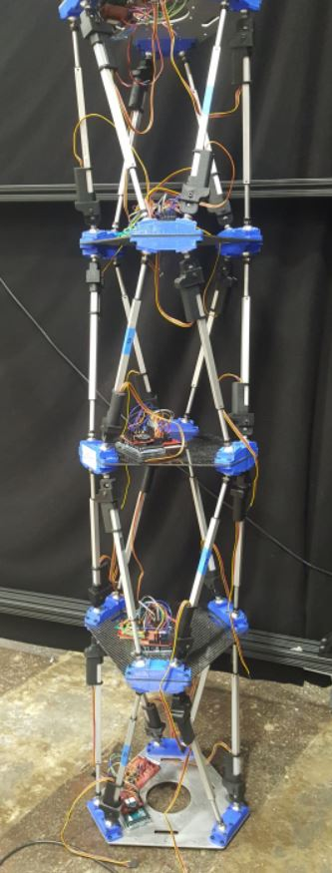
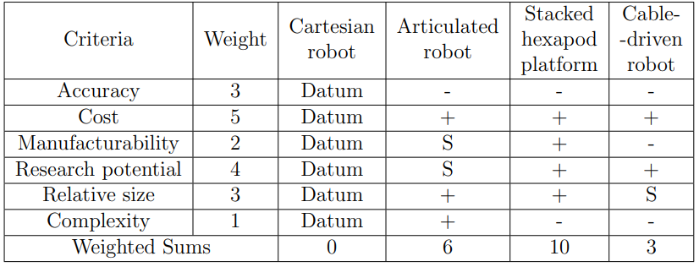
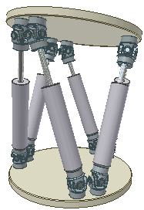
Design Inspiration
Need a 6-degree-of-freedom (6-DOF) actuator
Low cost, high research potential, high accuracy
Stewart platform (“hexapod”) is 6DOF
NASA research, stack hexapods to increase range
Use in spacecraft equipment manipulation
Notes:
Explain why SHP was chosen over other actuators

Slide 11
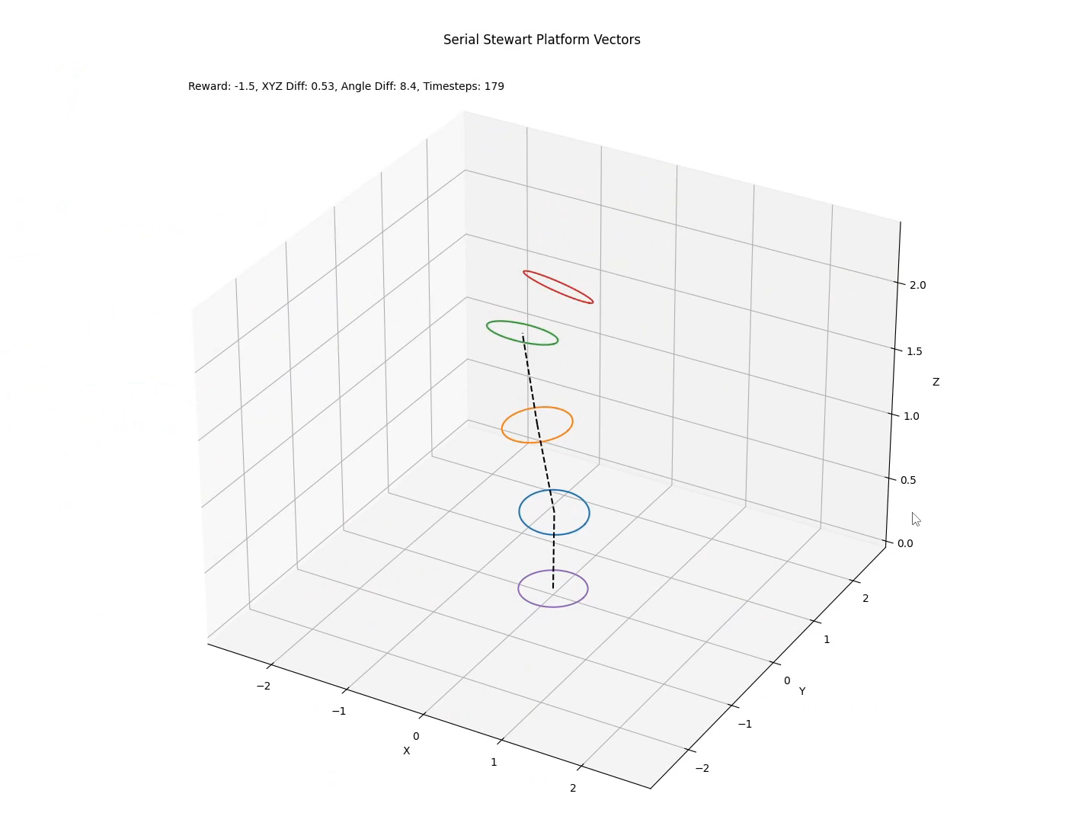
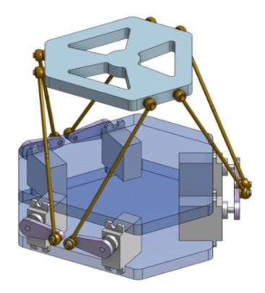
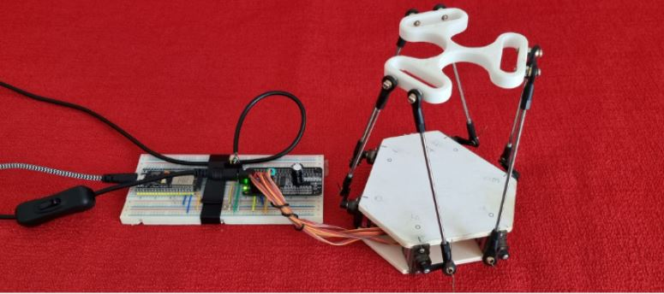
Previous Works*
CSC 580: Artificial Intelligence, designed deep RL agent to control a stacked hexapod platform
Nicolas Jeanmonod, engineer, designed open-source hexapod controller for ESP32 microcontrollers
Thesis builds off Nicolas’ work, modifies it to work with four stacked platforms
Notes:
Mention Nicolas and his implementation

Slide 12
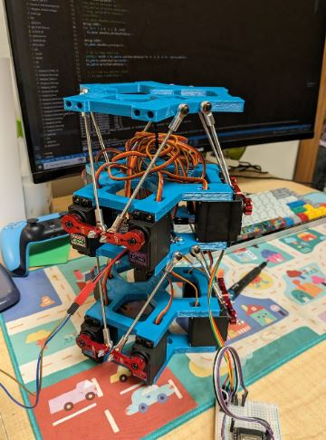
Design Overview
Four identical stacked hexapod platforms
Reduces complexity and cost
Independent control for each platform
Current version: identical control
3D-printed and off-the-shelf components
Purchased from Amazon and Ace Hardware
Total cost: $292
Name: Four-Stacked Hexapod Isometric Platform
Fo-SHIP (pronounced “faux ship”)

Slide 13
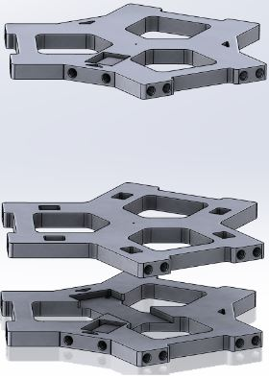
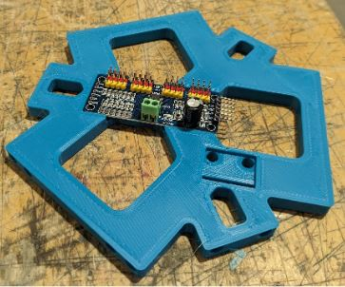
Mechanical Design
Designed five unique 3D-printed plates
Re-use simplifies manufacturing process
Heat-set inserts allow threaded connections
Electrical components have mounting slots
Base plate mounts to wooden base for stability
End effector plate has mounting holes for attaching array

Slide 14
Electrical Design
Multiple components need to interact and communicate
Microcontroller (ESP32) controls motors, makes decisions
Servo motors connected to PCA9685 motor driver
IMUs (angle sensors) detect orientation of each platform
DC power supply gives steady, high-amp electrical power
Different communications protocols between devices
ESP32 talks to motor drivers, IMUs over I²C
ESP32 talks to laptop, STM32 over serial (UART)

Slide 15
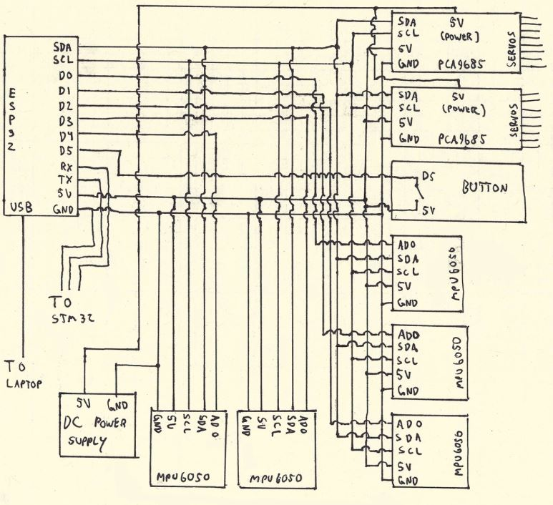
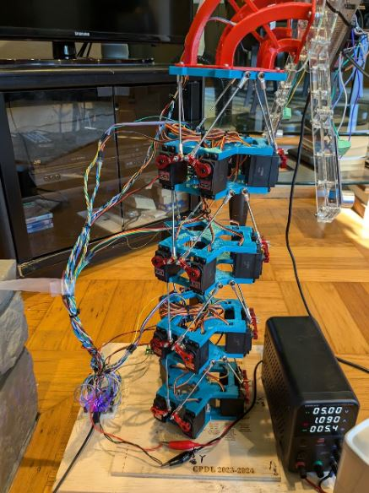
Wiring Diagram

Slide 16
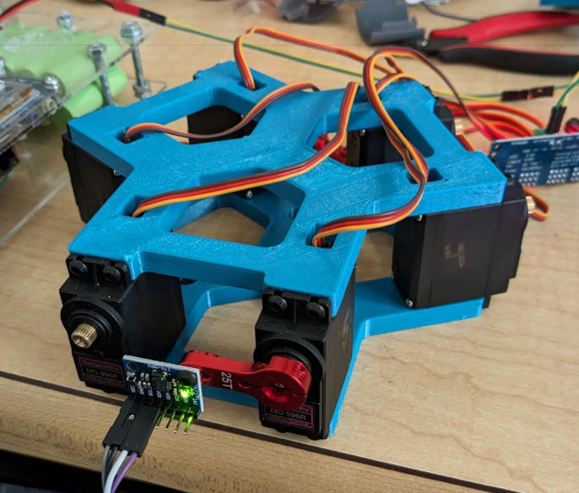
Manufacturing and Assembly*
Plates 3D-printed in Mustang ‘60 Machine Shop
Wooden base fabricated in Mustang ‘60
Fo-SHIP assembled in stages
Electrical boards attached to base plates, heat-set inserts installed with soldering iron
Servo motors sandwiched between plates
Servo arms, threaded rods attached to servo output, then connected to next platform with ball joints
Platforms assembled from base to top, wires secured with cable ties after assembly

Slide 17
Software Overview
Written in C++ for ESP32 microcontrollers (MCUs)
Main tasks and functions:
Calculate servo angles for a desired position
Move each platform to that position
Determine XYZ position of end effector
Communicate w/ acoustic positioning system MCU (STM32)
Send data to laptop for future processing / storage
Demonstration functions:
Full range-of-motion, active tracking of transmitter

Slide 18
Single-Platform Inverse Kinematics
Given a desired top plate position, what should servos set to?
Solution w/ linear actuators is simple
Move top plate to desired position
Determine coordinates of P
Set each actuator length to BP
With rotary actuators, more complex
Define triangle ΔBAP
BA must be length of servo arm
AP must be length of threaded rod
Use trig identities, quadratic formula
P
__
__
__
B
A

Slide 19
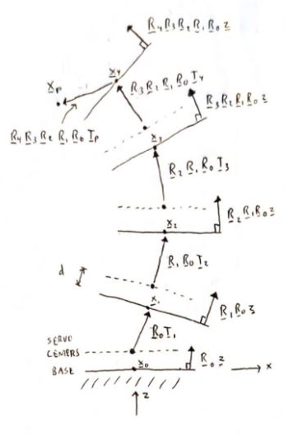
Multi-Platform Forward Kinematics
Orientation of each platform affects the one above it
Position of each platform given in local frame
Can be converted to global (“test”) frame
Describe each platform with two vectors
Translation – how does top plate shift in XYZ?
Rotation – what is normal vector to top plate?
Assume base of Fo-SHIP is on XY plane
Rotate each translation vector by orientation of platform beneath it, stack end-to-end

Slide 20
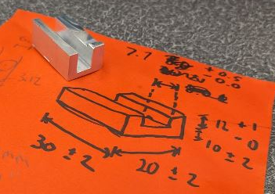
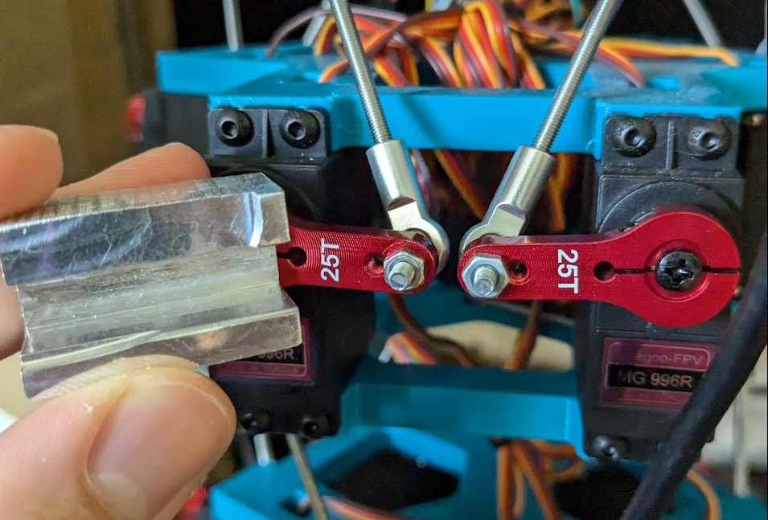
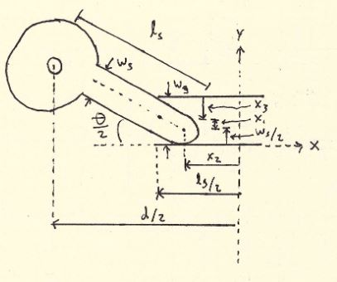
Servo Offset Calibration
Each servo motor has slightly different “zero” angle
Servo horns must be level for accurate positioning!
Manufactured go/no-go gauge in machine shop
Servo angle offsets adjusted in software until level
Max. angular misalignment of 3.7° between adjacent servos

Slide 21
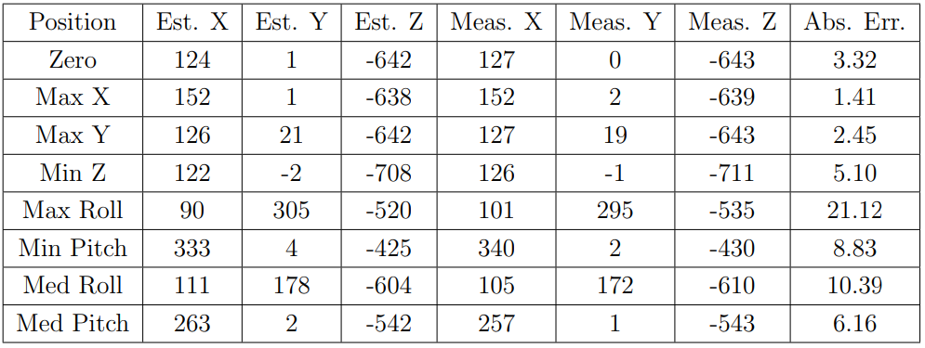
System Validation
Need to validate position estimate of Fo-SHIP end effector
Tested min/max of each axis, measured true position
Many potential sources of error:
Servo angular misalignments, incorrect platform dimensions
“Slop” in system compounds with each platform
Lower accuracy for larger angles/moves
Avg. error: 7.4mm Max. error: 21.1mm

Slide 22
Fo-SHIP Motion Demonstration

Slide 23
Acoustic Positioning System

Slide 24
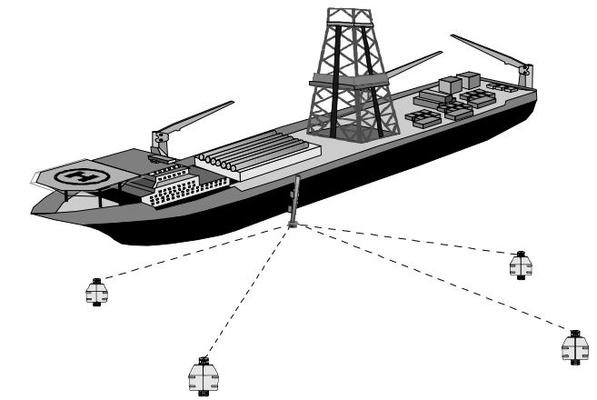
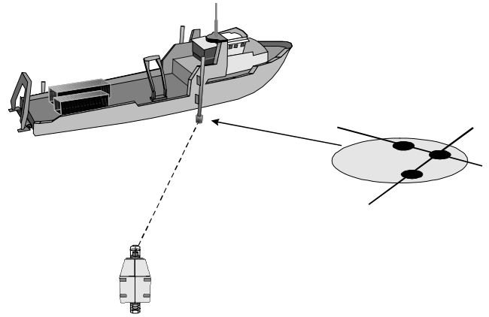
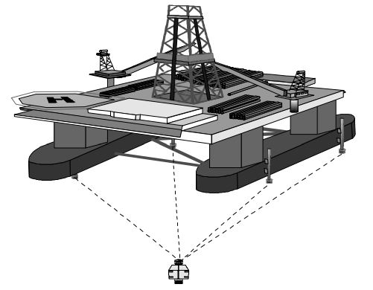
Long, Short, and Ultrashort Baselines
Main distinction in acoustic positioning systems is baseline
Baseline: spacing between receiver elements
Long baseline (LBL) uses spacing of >100m, fixed receivers
Ultrashort baseline (USBL) is <10cm, less than one wavelength
Short baseline (SBL) is in-between, mics usually on ship hull

Slide 25
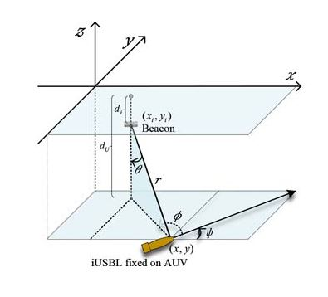
Inverted Short Baseline
USBL and SBL systems have receivers at surface of water
Inverted USBL (iUSBL) systems put receiver module on AUV
Single receiver module / housing
Inverted SBL (iSBL) would put receivers on body of AUV
Spacing can be > one wavelength
Receivers can be anywhere on body, not constrained to single module
Greater spacing = better accuracy
Similar implementations exist, but none called iSBL (except this one!)

Slide 26
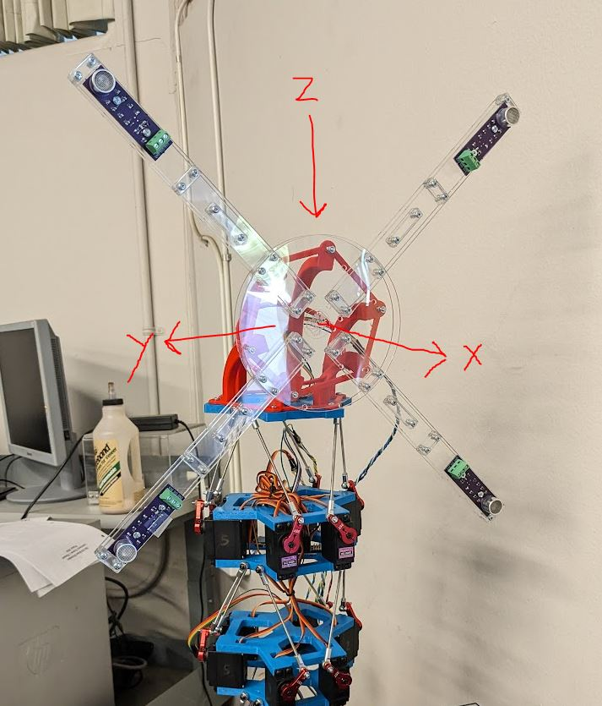
Receiver Array Mechanical Design
Array mimics body of AUV
Receivers spaced 25cm apart
Array made from laser-cut acrylic for lightweighting and lowering cost
3D-printed 90° adapter for attaching to Fo-SHIP end effector
Microcontroller, IMU, and breadboard mount on face of array
Coordinate system is NED

Slide 27
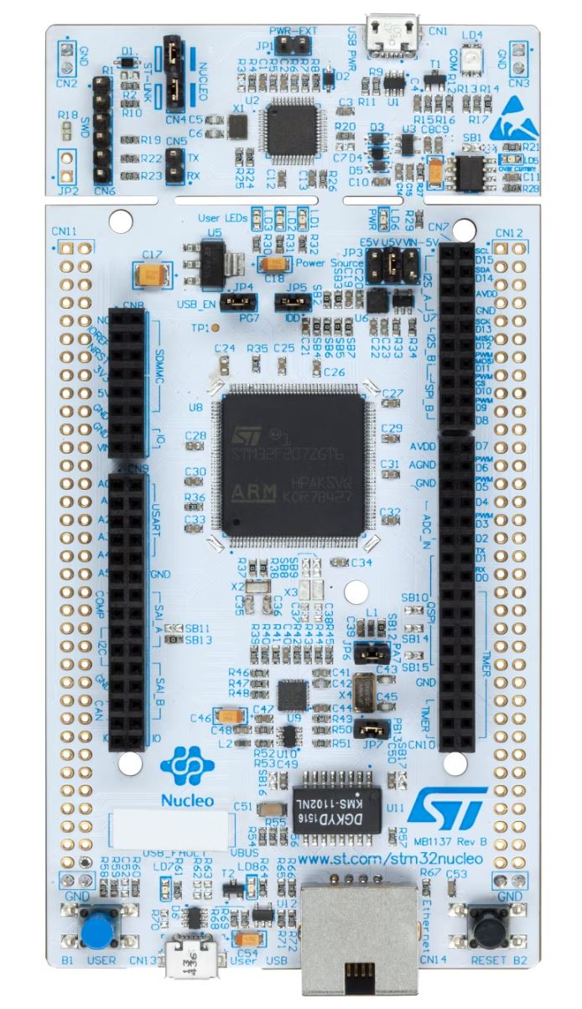
Receiver Array Electrical Design
STM32H723 high-performance microcontroller
Records at >1 million samples per second
Has >200kB of RAM for temporary data storage
High CPU clock speed of 550MHz
Communicates with Fo-SHIP ESP32 over UART
Reads from IMU over I²C
Connected to laptop with USB for debugging
Records from four microphones at 851.4kHz each
Smoothing capacitors for filtering electrical noise

Slide 28
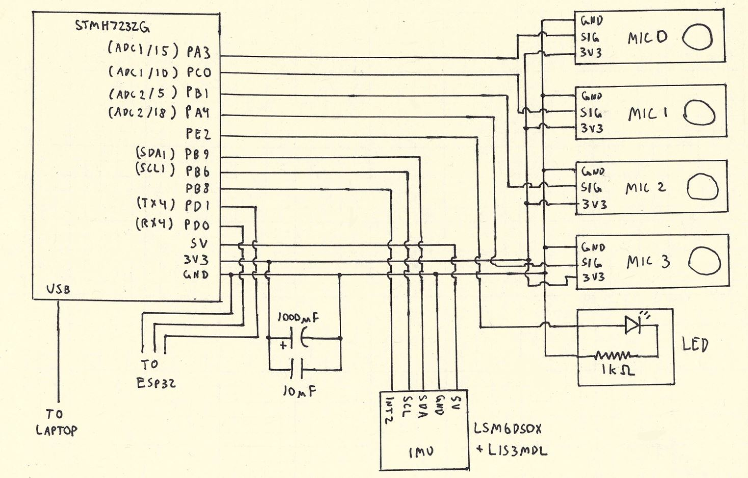
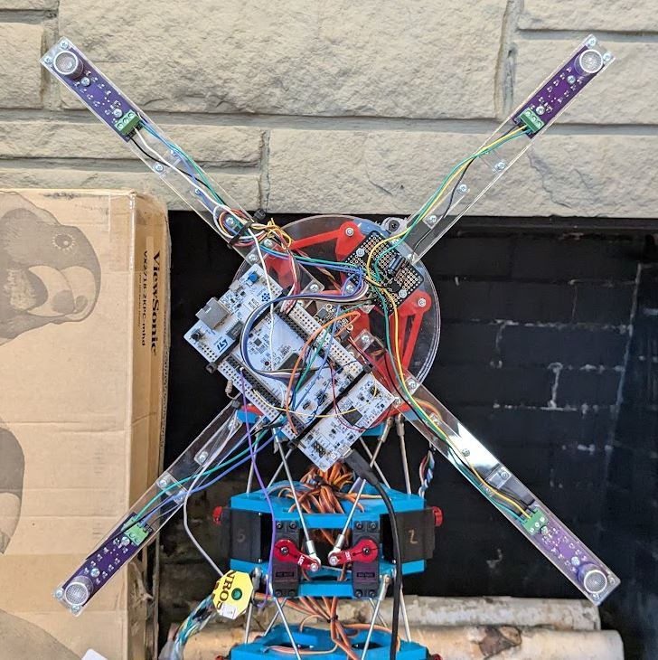
Receiver Array Wiring Diagram

Slide 29
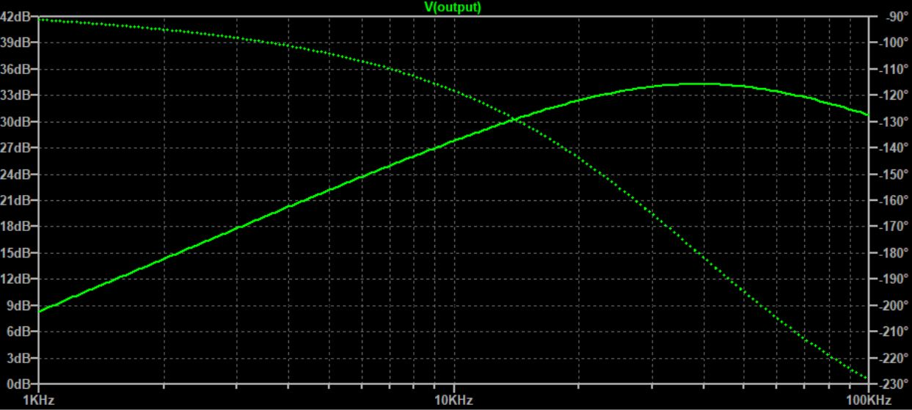
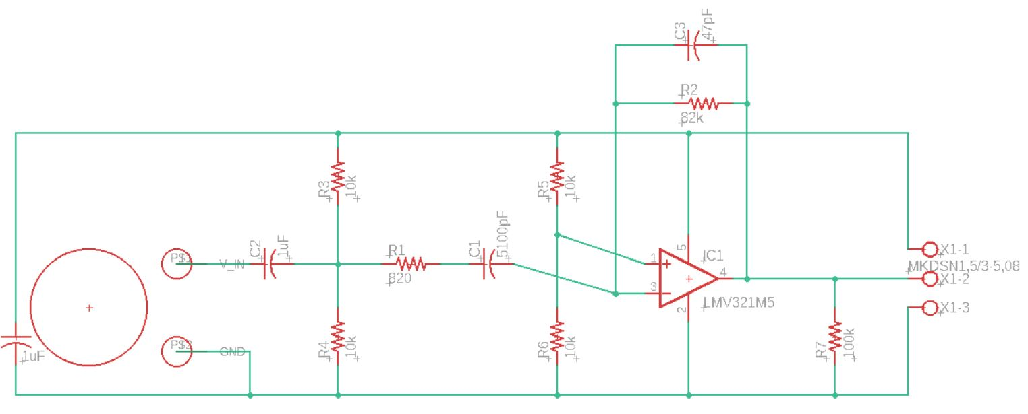
Active Band-Pass Filter Design
Raw ultrasonic receivers not sensitive enough, need boosting
Active band-pass filter provides amplification and filtering of non-40kHz signals (receiver operating frequency)
Adds 1.65V DC offset to use full range of ADCs
Provides gain of 34.5dB at operating frequency

Slide 30
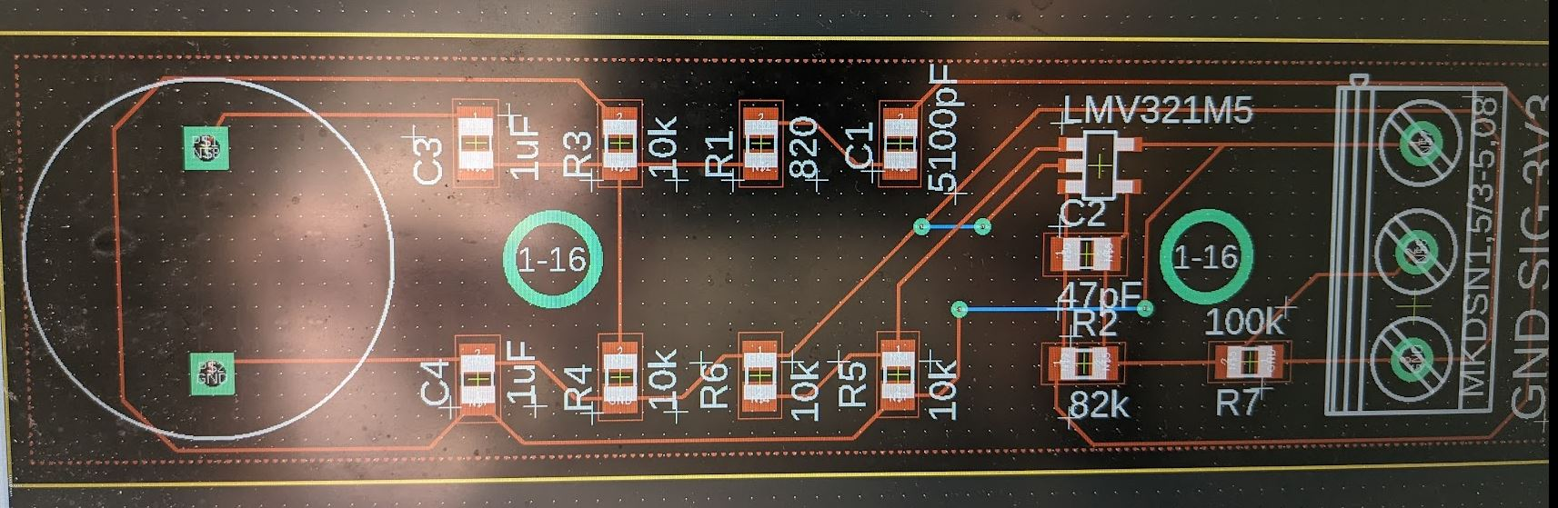
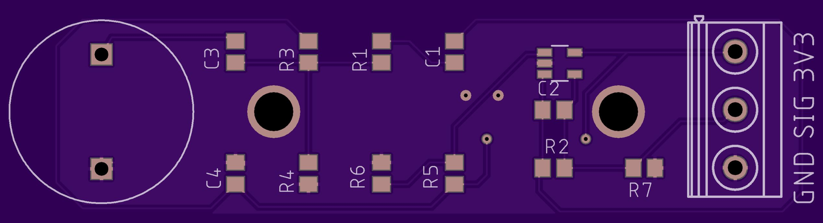
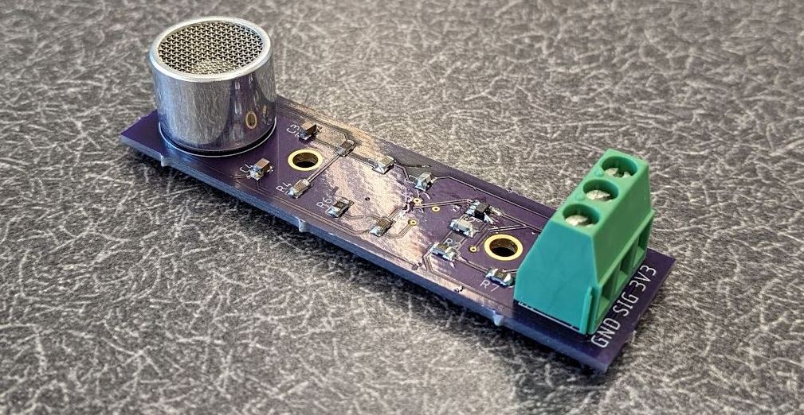
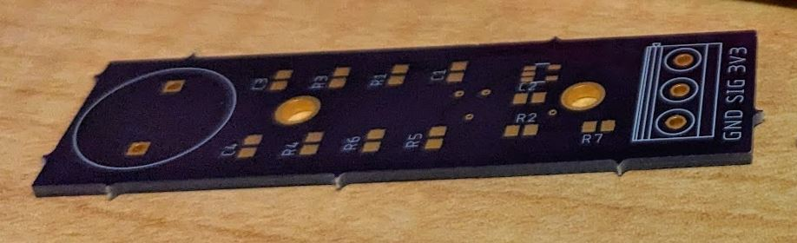
Active Band-Pass Filter PCB
Custom printed circuit board (PCB) designed in Eagle
Manufactured by OSH Park
Components ordered from Mouser Electronics
Uses common resistor and capacitor values to lower cost
Notes:
quick

Slide 31
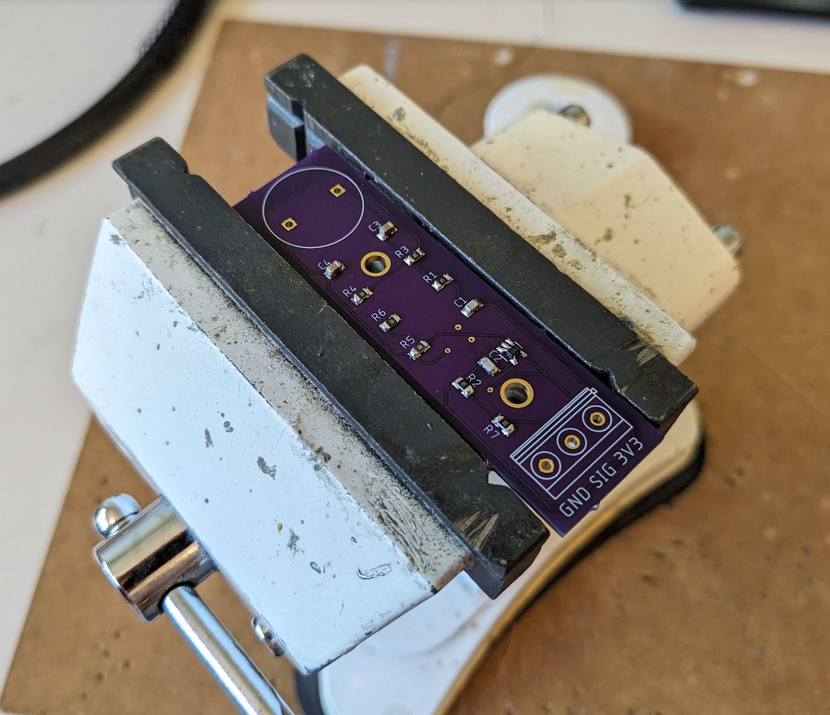
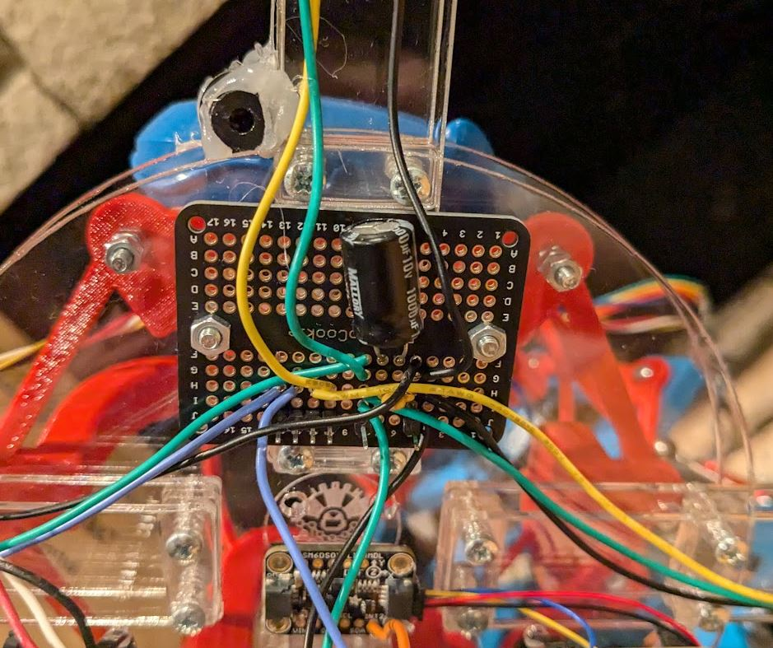
Receiver Array Assembly*
Active band-pass filter PCBs soldered by hand
Soldered breadboard used to route power and mic signals
Wires cut to connect PCBs to breadboard and STM32
Array frame assembled with screws, attached to 90° adapter
STM32, IMU, and breadboard secured to face of array with screws and adhesive
Wires secured with cable ties

Slide 32
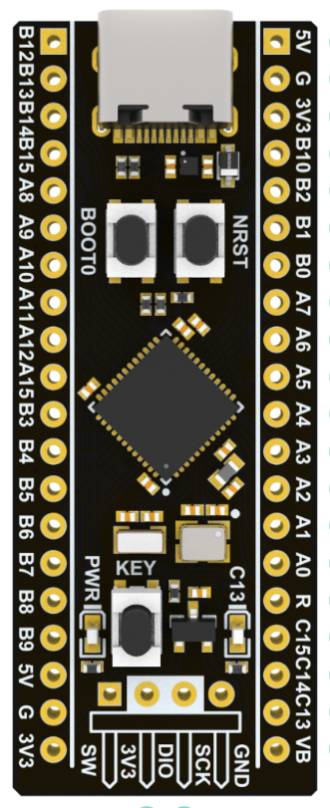
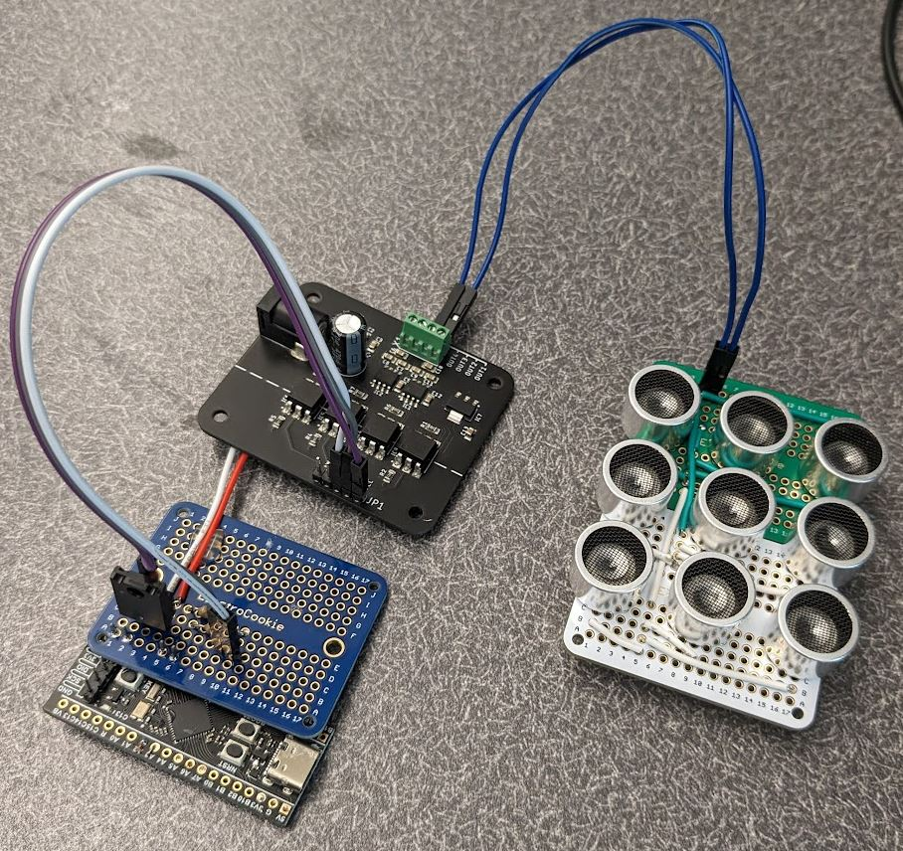
Transmitter Hardware Design
STM32F411, small form factor microcontroller
Only need two GPIO pins, one timer
Problem: how to drive 40kHz ultrasonic transmitter?
Multiple motor drivers tested, all failed
High update rate required (>80kHz), high voltage (12V)
Charlie donated optical-switching motor driver, successfully drives transmitter (thanks Charlie!)
Tested multi-element transmitter, cause phasing issues; single transmitter used for testing

Slide 33
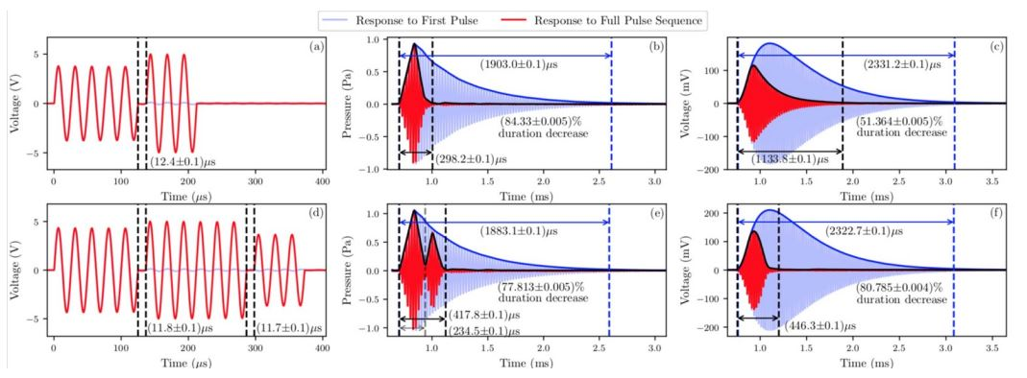
Engineered Ultrasonic Waves
Operating at receiver resonant frequency for best range
Problem: resonance increases sensitivity, but adds ringing!
Sending just one pulse (12.5us) rings for 2300us
Sharper pulse recordings = better time-differencing
UK researchers designed waveform to reduce ringing by 81%
Wave pattern: 5 in-phase 6 out-of-phase 3 in-phase

Slide 34
Transmitter Software Design*
Implemented engineered waves into transmitter code
One “pulse” = one wave pattern (5-6-3)
Approximated pattern as square wave
Original goal was to transmit GPS coordinates over ultrasonic
Convert coords to character string: “x=20” -> “x”, “=“, “2”, “0”
Convert to ASCII 8-bit representation: “x” -> “01111000”
Send one pulse for 1s, wait (no pulse) for 0s
Currently sending random8-bit character using above system
Added 6-bit header to “trigger” recording on STM32
Sending pulses at 2000kHz, one per 0.5ms

Slide 35
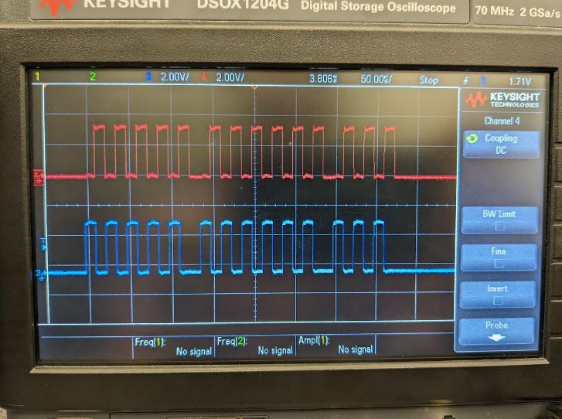
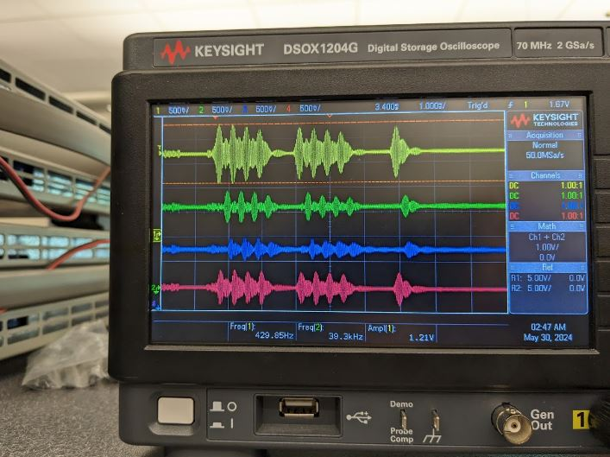
Transmitter Output

Slide 36
Finite-State Machine Representation*
Acoustic positioning system program (running on STM32) has five main states
Initialization: starting timers, setting up algorithms, etc.
Triggering: checks for acoustic pulse every 0.1ms
Full Recording: once detected, records for 2.4ms
Recording Validation: checks if recording actually contains the acoustic pulse (a “good recording”)
Data Processing: converts a good recording to a new position estimate and sends data to Fo-SHIP ESP32

Slide 37
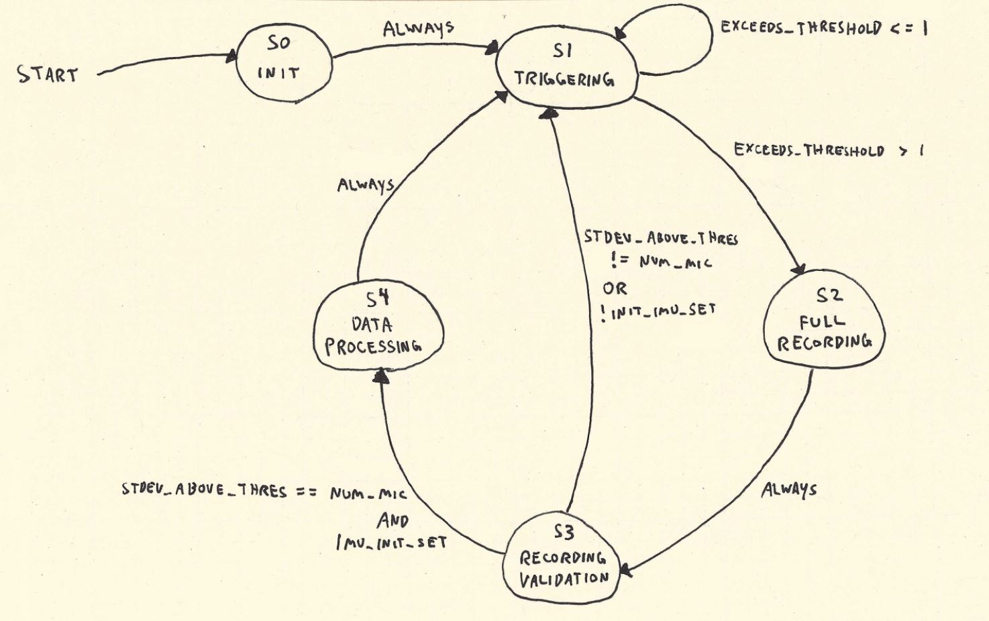
Finite-State Machine Diagram

Slide 38
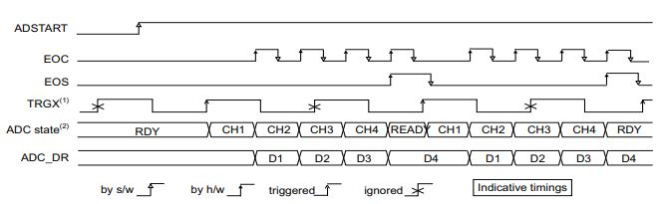
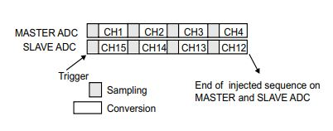
Analog-to-Digital Converter Setup*
Analog-to-digital converters (ADCs) can measure voltages between 0 and 3.3V on STM32 GPIO pins
12-bit resolution (0.81mV) used, 0.42us per conversion
If sequential (Mic0 -> Mic1 -> …), max sampling rate is 595kHz
Using MultiMode (dual ADC), can double max sampling rate
Primary ADC triggers secondary, two conversions at once

Slide 39
Triggering State
After initialization, first step is to check for an incoming pulse
Active band-pass filter removes non-40kHz audio
Assume any large readings from the ADC -> pulse incoming
Record 64 samples from each mic, check if any five samples in a row exceed a threshold; if so, pulse detected
One 40kHz wave -> 21.3 samples, five samples is enough
More samples/mic -> longer trig time -> less recording time
64 is good middle-ground, takes 0.1ms to record and check
If any two mics > threshold, move to full recording state
Otherwise, repeat triggering process

Slide 40
Full Recording and Validation States
Full recording, 2048 samples per mic (2.4ms / 7ms full pulse)
IMU processing halted during full recording to prevent noise
Once saved, need to verify that recording contains pulse
Calculate standard deviation for each microphone signal
If std. dev. of all four mics > threshold, then recording is there
Threshold set just above ambient noise level
Area for improvement: use average of std. dev’s to determine how much to trust an acoustic measurement?

Slide 41
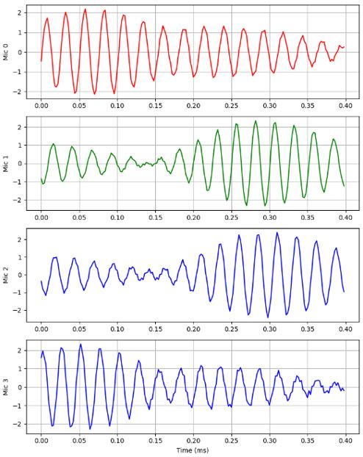
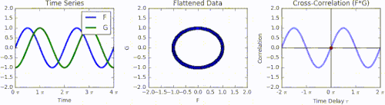
Determining Time Shifts
Problem: need to find time shift between four mic signals
Assume signals are identical in shape, but time-shifted
Compare only two signals at a time
Solution: use cross-correlation!
Shifts signals over each other, peak of output shows time shift

Slide 42
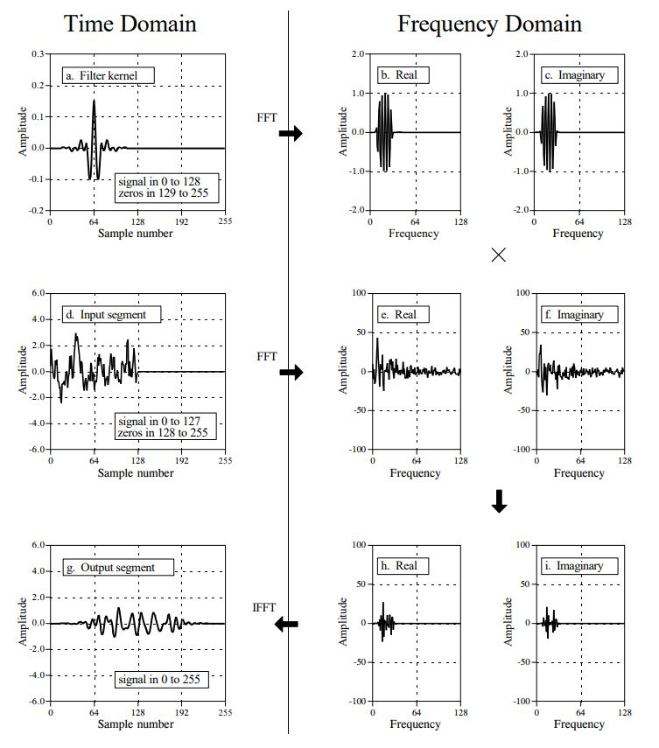
FFT Cross-Correlation Theory*
Problem: cross-correlation is very slow
Solution: use fast Fourier transforms to speed up computation
Cross-correlation ≈ convolution
Convolution in time domain -> multiplication in frequency domain
Convert signals to freq. domain using FFT, multiply signals, then convert back to time domain with inverse FFT
Output is equivalent to normal method, but takes 99.9% less time (n_{samples}=4096)

Slide 43
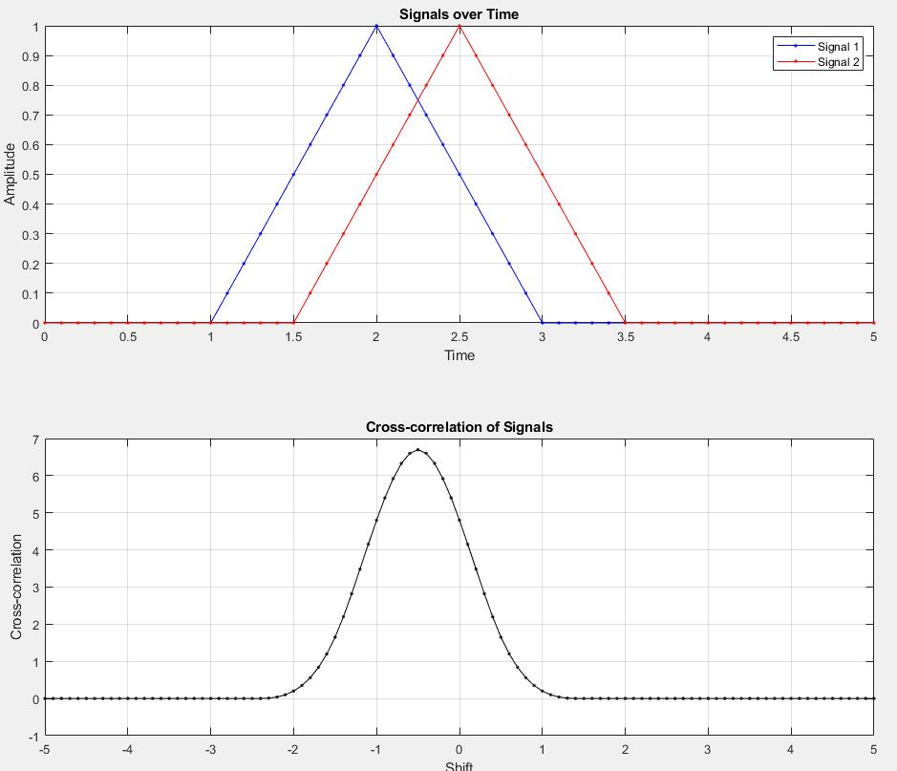
FFT Cross-Correlation Code*
FFT cross-correlation implemented in C using arm_math.h
Three comparisons: mic0 vs mic1, mic0 vs mic2, mic0 vs mic3
Only three unique pairs; choice of mic0 is arbitrary
For each pair:
“Flip” second signal
Take FFT of both signals
Multiply results of FFTs
Take inverse FFT of product
Find maximum of output
Convert index from sample# to time

Slide 44

Rotating the Receiver Array
Before converting time shifts to position, need to account for orientation of receiver array relative to test frame
Current orientation is known (Madgwick filter in background)
Create 3D coordinates for each microphone based on config
Rotate each point by current orientation of array
Now, position of each microphone is known in test (global) frame!

Slide 45
Residual Function
Position of each mic, and time shift between mics, is known
How to find transmitter position based on this?
Define a residual function r(tx_guess, mic_coords, time_shifts)
tx_guess: guess for transmitter coords in 3D (in test frame)
Calculate distance from tx_guess to each microphone
Convert to time-of-arrival (TOA) using speed of sound in air
Subtract TOAs between mics to get estimated time shifts
Find difference between estimated and measured time shifts
If tx_guess is at true transmitter position -> residual is zero!
If tx_guess is very far from true position -> larger residual

Slide 46

Hooke-Jeeves Search Algorithm*
Most likely transmitter position is minimum of residual function
Problem: need a way to find the minimum of 3D function
Solution: Hooke-Jeeves search algorithm!
Start with some initial position estimate
Test points s distance away in each dir.
Move in direction of lowest residual, with step size s, until residual begins to grow
Cut step size in half and test new dir’s
Halt when exit condition is met
Always converges, is very accurate for this residual function

Slide 47

Incorporating Transmitter Position
Hooke-Jeeves search returns position of transmitter relative to center of receiver array
Position of transmitter already known (GPS buoy)
Want to know position estimate of receiver array!
Receiver position = transmitter position – relative position
Finally, single estimate for center of receiver array using only acoustic measurements!
Position estimate in test frame
Can compare to true position (Fo-SHIP)

Slide 48
Single-Pass Overview
Transmitter sends an acoustic pulse towards receiver array
ADCs trigger, pulse is recorded on four mics and verified
Time shift between signals found using FFT cross-correlation
Position of each microphone rotated using current orientation
Hooke-Jeeves search finds minimum of residual function
Returns position of transmitter relative to center of array
Use known transmitter location to get position estimate of center of receiver array in test frame

Slide 49
Absolute Orientation and Dead Reckoning

Slide 50

MEMS IMUs
Inertial measurement units (IMUs) measure linear acceleration, angular velocity, and magnetic field strength
Micro-electrical mechanical systems (MEMS) are devices made using semiconductor fabrication technology
MEMS IMUs found in every smartphone
Tilt sensors, compass
Medium-end IMU chosen for this thesis
LSM6DSOX + LIS3MDL

Slide 51


Sensor Fusion Algorithms
IMUs give raw data: acceleration, angular rate, magnetic field
Need to convert to orientation using sensor fusion!
Many different techniques: EKF, Mahony, Madgwick, complementary
Basic idea:
Accelerometer finds “down”
Magnetometer finds “north”
Gyroscope finds change in orientation
Use acc/mag for long-term stability, gyro for short-term changes

Slide 52

Madgwick Filter Theory*
Invented by Sebastian Madgwick, efficient IMU fusion algorithm
Represents orientation using quaternions, avoids gimbal lock
Uses gradient descent, formulates algorithm as optimization problem
Current orientation q, acc reading s, gravity vector d
Want to drive f(q,d,s) to zero (orientation estimate matches sensors)
Similar equations for mag readings (and north vector)
Gyro measurements used for relative orientation change
Start with initial orientation estimate, converges on correct orientation

Slide 53

Madgwick Filter Block Diagram*
Combine absolute measurements (acc/mag) with relative movement (gyro) to converge on correct orientation
Runs at 208Hz (acc/gyro update rate), converges within ~20 seconds
Runs constantly in background on STM32, simultaneously with acoustic positioning system

Slide 54

Madgwick Filter Tuning 1
Beta is only tuning parameter – controls acc/mag to gyro ratio
Large beta -> trust acc/mag more, noisy readings

Slide 55

Madgwick Filter Tuning 2
Small beta -> trust gryo more, smoother but leads to drift
Need to find balance: no drift, smooth signal, fast response time

Slide 56

Madgwick Filter Tuning 3
Beta = 0.11 gave best results, used in final implementation

Slide 57
Dead Reckoning Overview
Used for centuries in ship navigation, still used by submarines
Start with known position, integrate velocity + heading over time
Going north at 10mph for 12 minutes, east at 4mph for 5 mins…
With precise equipment, can be very accurate for short time period
Errors accumulate over time; position becomes very inaccurate
Best MEMS IMUs only accurate to 50m within 10 minutes
Better IMUs (>$10000) accurate for hours
However, error resets after new absolute position measurement
Use dead reckoning to estimate change in position since last acoustic measurement; might improve results?

Slide 58
Dead Reckoning Assumptions
MEMS IMUs not very good candidate for dead reckoning
Double integration: acceleration -> velocity -> position
Acc measurements must be rotated to global frame
Sensors have considerable noise, can lead to drift
Assumptions:
Fo-SHIP movement is not smooth – when moving, accelerometer is always measuring accelerations
Movement is intermittent – move, then hold for 3+ seconds
Fo-SHIP starts and ends at rest; start and end velocity = 0

Slide 59
Dead Reckoning Implementation
Initialize with zero velocity, zero change in position
Check if accelerometer measurements are > threshold
If so, rotate measurement vector by current orientation
Integrate rotated acc’s into change in velocity (a × ΔT = Δv)
Add change in velocity to current velocity (v_{n+1} = v_{n} + Δv)
Integrate current velocity into change in position (v × ΔT = Δx)
If accelerations < threshold for set period of time, assume array is stationary and apply velocity drift compensation
When new acoustic pulse detected, return change in position

Slide 60

Velocity Drift Compensation*
Velocity before and after movement should be zero
Errors accumulate and produce non-zero final velocity
Subtract area of triangle, rectangle to remove drift from pos

Slide 61

Dead Reckoning Validation
Without assumptions, dead reckoning result was horrible
Thresholding removes effect of noise when stationary
Vel drift compensation removes error build-up, limits errors to movement time
Tested dead reckoning estimate, often wrong by large factor
During stationary tests (no movement), dead reckoning works perfectly
Might help acoustic position estimates, can tell vaguely how system moves

Slide 62
Kalman Filtering

Slide 63
Kalman Filter Introduction
Rudolf E. Kálmán pioneered method for filtering linear systems
Optimal solution for separating random noise from signals
Very common in controls engineering
Great for estimating unmeasurable states, filtering noisy measurements
Assumes linear system – equations in linear form (y = Ax + b)
Extended (non-linear) variants exist, but more complex
Only linear systems used in this thesis for simplicity

Slide 64

Airplane Example*
Imagine a plane flying in a straight line
Velocity and position measurements available, but noisy
Want to combine measurements to get best position estimate
Assume constant velocity
v_{n+1} = v_{n}
x_{n+1} = x_{n} + v × ΔT
True plane can accelerate!
Accelerations treated as random noise

Slide 65

Kalman Filter Overview*
Three steps: initialization, prediction, update
Initialization: system is defined, initial state estimates chosen
Prediction: use system model to estimate new state
Update: use measurements to correct prediction state
Prediction step can be run as frequently as desired (constant position estimate)
Update step only run when new measurements available

Slide 66
Initialization Step Theory 1*
x, state vector: variables to be tracked in system
Ex: position and velocity of plane
z, measurement vector: variables being measured
Ex: GPS position estimate and plane velocity measurement
F, state transition matrix: estimate next state based on current
Ex: constant velocity model ( v_{n+1} = v_{n}, x_{n+1} = x_{n} + v × ΔT)
H, state-to-measurement matrix: how are measurements related to states?
Ex: state and measurement are the same! Identity matrix

Slide 67
Initialization Step Theory 2*
P, state covariance matrix: how uncertain is the current state?
Ex: if certain airplane starts at rest (v = 0), but not sure where it starts (x = ?), large value for position uncertainty
Q, process noise matrix: how good is the system model?
Ex: model assumes no acceleration! So, uncertainty for velocity is much higher than uncertainty for position
R, measurement noise matrix: how noisy are measurements?
Ex: if GPS is inaccurate (< 3m) but velocity is (< 0.1m/s), then value for position is larger

Slide 68


Prediction Step Theory*
Estimate next state based on current state
Update state covariance matrix
Matrix gets larger each update
More predictions without measurement updates -> less trust in state estimate

Slide 69




Update Step Theory*
Compare new measurements to state estimate
Compute Kalman gain
K represents trust in measurements vs state estimate
Update state estimate and state covariance matrix
State cov. matrix gets smaller; measurements restore trust

Slide 70

Software Implementation*
Implemented in C using custom struct and functions
Uses matrix operations from arm_math.h library
Each step gets own function
Predict and update steps called after new pulse recorded
Two models: one with just acoustic est’s, one with acoustic + dead reckoning

Slide 71

iSBL Kalman Filter Design
Model only uses acoustic position estimates
In airplane example, only using GPS readings (no velocity)
Assume constant velocity model in three dimensions (XYZ)
State: position and velocity for each axis
Measurement: position for each axis
Assume high uncertainty for velocity
Effectively smooths out acoustic position estimates, more resistant to random noise

Slide 72

iSBL-SF Kalman Filter Design
Incorporate dead reckoning change-in-position estimate, use to improve acoustic position estimate
System dynamics are the same; system has not changed
Measurements: position and change in position for each axis
State-to-measurement matrix transforms change-in-position estimate into velocity (Δx = ΔT × v)

Slide 73
Kalman Filter Tuning*
System dynamics used for most matrices and vectors in KF
Three matrices can be tuned to improve KF results
P, state covariance matrix: provides quicker convergence, initial state estimate; usually set equal to Q
Q, process noise matrix: can cause divergence; consider system assumptions when tuning
R, measurement noise matrix: can cause mistrust / too much trust in certain measurements; measure sensor output and calculate variance of each

Slide 74
Data Collection and Results

Slide 75
Testing Plan
Want to answer specific questions with testing:
How does distance affect position estimate accuracy?
How does angle affect accuracy?
Do stationary tests give better results than moving tests?
Does rapid movement give worse results than gradual movement?
Evaluate normality of results; is normal assumption valid?
What is overall accuracy of the system? Each KF? Raw data?

Slide 76

Test Environment
Performed testing at home on level ground
Measured true position using measuring tape, rulers, calipers, and levels
Estimated measurement accuracy: ±0.5cm
Performed 9 tests
Different distances
Different angles
Tested maximum distance and angle, minimum distance

Slide 77
Data Collection Summary
Best to worst performance:
iSBL KF, raw iSBL data, iSBL-SF KF
Total number of samples: 21572, total testing time: 30 hours
Y-accuracy is worse than z-accuracy; IMU yaw (from magnetometer) is most noisy angle measurement
Dead reckoning reduces accuracy; poor measurements
KF improved over raw iSBL data, helped smooth out results
Estimated accuracy has average uncertainty of ±12.4mm

Slide 78

Effect of Distance on Accuracy - Far

Slide 79

Effect of Distance on Accuracy - Close

Slide 80

Effect of Distance on Accuracy - Trend

Slide 81

Effect of Angle on Accuracy - Large

Slide 82

Effect of Angle on Accuracy - Small

Slide 83

Effect of Angle on Accuracy - Trend

Slide 84

Stationary vs Moving Accuracy - Stationary

Slide 85

Stationary vs Moving Accuracy - Moving

Slide 86

Gradual vs Rapid Accuracy - Gradual

Slide 87

Gradual vs Rapid Accuracy - Rapid

Slide 88

Evaluating Normality

Slide 89


Data Collection Results Table

Slide 90
Active Tracking Demonstration

Slide 91
Conclusion and Future Work

Slide 92
System Overview and Recap
Average positioning accuracy is less than Fo-SHIP uncertainty
Need more accurate ground-truth system to properly define iSBL-KF accuracy
On average, iSBL-KF position estimate is within 12.4mm of true position
For individual estimate, much less accurate; standard dev. is 43mm for Y-axis, 21mm for Z-axis
Lots of moving parts, sources of error, non-isolated variables
Work provides great foundation for future research

Slide 93
Extrapolation to Underwater Regime
Speed of sound is 4.3x faster in water than air
Position accuracy depends on accurate time-differencing
Faster speed of sound -> faster ADC sampling rate required
Sound attenuates much less in water than air
>1000x better propagation for 40kHz sound
Much less powerful transmitters required for same distance
~60mm average positional accuracy between 6-16.5m deep
Yaw axis (main factor in y-error) plays bigger part underwater
More accurate dead reckoning available (DVL)
Sound bends as depth, temperature, salinity changes

Slide 94
Recommendations for Future Work
Design system for verifying microphone position
Large impact on acoustic position estimate
Use more than four microphones – better estimate accuracy
Use better dead reckoning and orientation equipment
Implement tightly-coupled extended Kalman filter
Fuse IMU and acoustic position estimate more closely
Use less-directional transmitters and receivers
Tune Kalman filter matrices more rigorously
Use more accurate ground-truth positioning system!

Slide 95
Accomplishments
Completed 95% of thesis in five months
Written ~120 pages, ~40000 words, ~5000 lines of code so far
Designed, built, calibrated, and tested novel(-ish) robot
Implemented multiple algorithms with little prior knowledge
Honed skills across mechanical, electrical, software, and controls engineering (among many other areas)
Kept budget under $600
Did bulk of project entirely solo (with advising from committee)
Faced failure after failure, and kept persevering

Slide 96
Questions

